Slide 1
UNIT I
TOURISM SYSTEM
Topic:
Travel demand and supply management in tourism system

Slide 2
Tourism supply components
Natural resources and environment
Built environment
Operating sectors
Spirit of hospitality

Slide 3
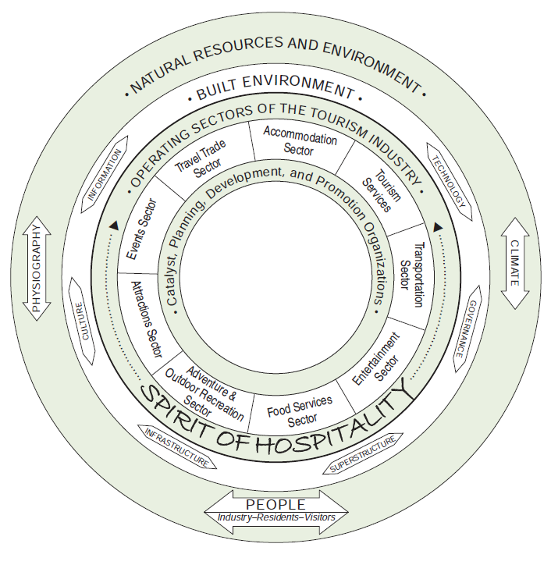
Components of Tourism Supply

Slide 4
Built environment
Infrastructure and superstructure
Hotels, recreational parks
Auto traveler services
Bicycles, motorcycles,automobiles, public transport
Roadside parks
picnic tables, rest areas, scenic turnout

Slide 5
Operating sectors
Accommodations
Supply: Condominiums timesharing & hotel classification
Transportation
Types: Air, motorcoach, ship and boat, rail and taxis

Slide 6
Spirit of hospitality and cultural resources
Activities tourist enjoy most
Shopping
Entertainment, Recreation and other activities
Entertainment, special events, museum and art galleries and sports

Slide 7
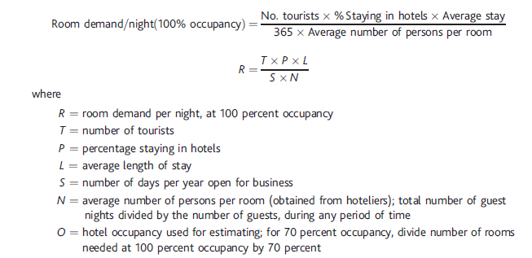
Matching supply with demand

Slide 8
Demand to a destination
D (Demand) = f (propensity, resistance)
Resistance is inversely related to the demand
Propensity depends on
Psychographics
Demographics (Socioeconomic status)
Marketing effectiveness
Resistance depends on
Economic distance
Cultural distance
Cost of services
Quality of services
seasonality

Slide 9
